Slide 1


3.5 Combinational Circuits
29
We have designed a circuit to implement the Boolean function:
This circuit is an example of a combinational or combinatorial logic circuit.
Combinational logic circuits produce a specified output at the instant when input values are applied.
  In a later section, we will explore circuits where this is not the case.

Slide 2
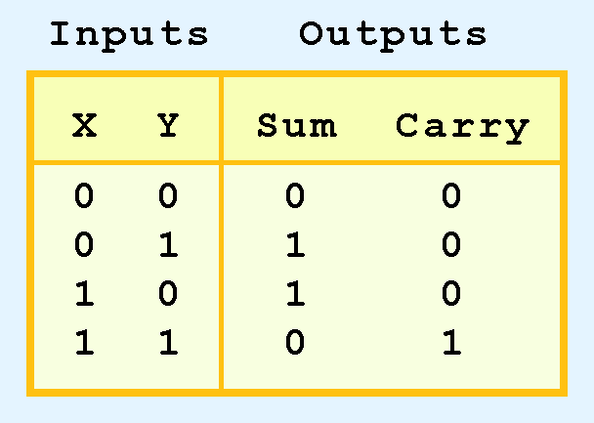
3.5 Half Adder
30
Combinational logic circuits give us many useful devices.
One of the simplest is the half adder, which finds the sum of two bits.
To build a half adder, look at its truth table, shown at the right.
It has two inputs and two outputs.

Slide 3
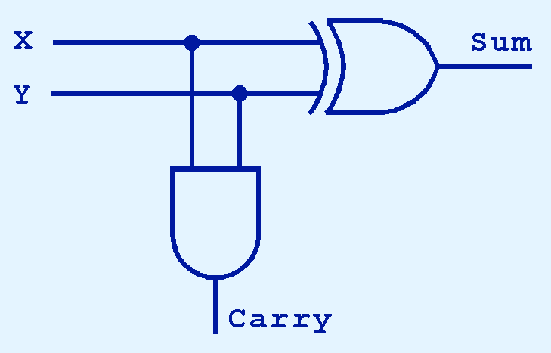
3.5 Half Adder
31
As you can see, the sum can be calculated with XOR
  SUM(X, Y) = X XOR Y
The carry can be calculated with AND
  CARRY(X, Y) = X AND Y

Slide 4
3.5 Core Point of Course
31b
We have now reached the central point of this course.
We have used gates to build an arithmetic function
We needed to use the binary number system to do so
Every aspect of building a computer derives from this ability to use gates to build arithmetic functions.

Slide 5
3.5 Core Point of Course
31c
First, we will see how to extend the half adder to a full adder.
  In addition to adding two bits and producing the result and a carry, a full adder can take in a carry from a previous column.
  Thus full adders can be chained together to add multi-bit numbers.
Then we will see how to build an ALU.
Later we will also see how to build logic functions such as “if” by first using the assembler to convert a program to a binary string.

Slide 6
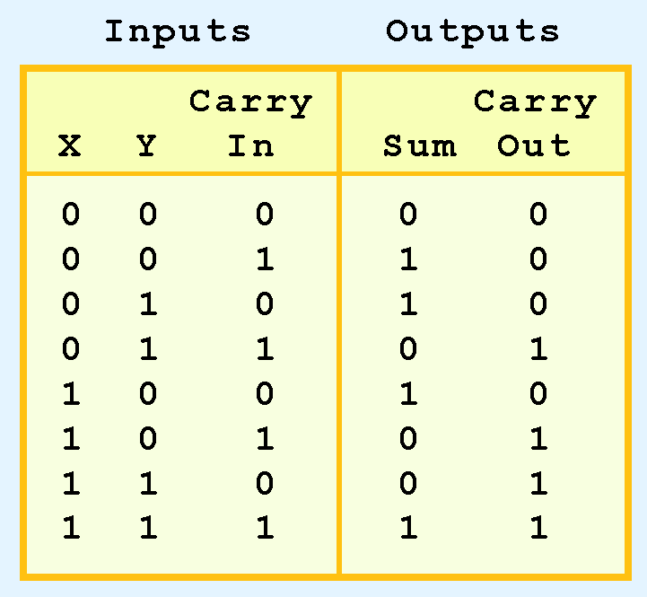
3.5 Full Adder
32
A full adder handles the complete calculation of one column of a binary addition.
It has 3 inputs and 2 outputs.
The truth table for a full adder is shown at the right.

Slide 7
3.5 Full Adder
33
How can we change the half adder shown below to make it a full adder?

Slide 8
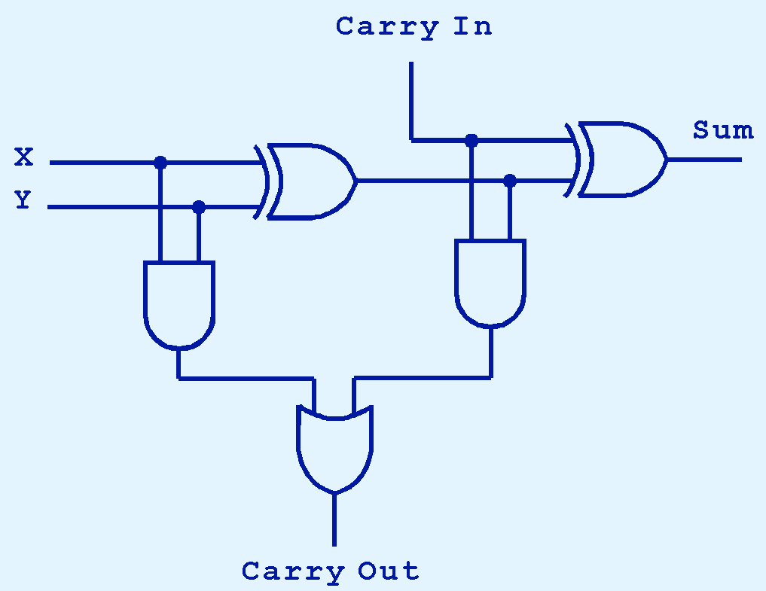
3.5 Full Adder
34
SUM-FULL (X, Y, carry-in) =
SUM(SUM (X, Y), carry-in) = (X XOR Y) XOR c-in
When a circuit has multiple outputs, we build each output separately.
This slide explains how to build the
SUM-FULL output.

Slide 9
3.5 Full Adder
34b
CARRY-OUT (X, Y, carry-in) =
CARRY(X, Y) OR CARRY(SUM(X, Y), carry-in) =
(X AND Y) OR (SUM(X, Y) AND carry-in)
This slide explains how to build the
CARRY-OUT output.

Slide 10
3.5 Full Adder
34c
The equations above should match the truth table.

Slide 11

3.5 Ripple-Carry Adder
35
Full adders can be connected in a series.
The carry bit “ripples” from one adder to the next; hence, this circuit is called a ripple-carry adder.
Current computers use more complex circuits that are more efficient.
| | |
z15 z1 z0

